Slide 1
Psychedelic Treatments:
Overview and Current Status in VA
October 2025
Presenters:
Dr. Ilse Wiechers, Acting Deputy Assistant Undersecretary for Health for Patient Care Services, Veterans Health Administration (VHA)
Dr. Wendy Tenhula, Deputy Chief Research and Development Officer, Office of Research and Development (ORD), VHA
Notes:
Confirm Arial font throughout

Slide 2
Agenda
Review state of the science for psychedelic treatments
Review state of VA psychedelic research
Proposed FY26 Priorities for Psychedelic Integrated Project Team (IPT)

Slide 3
Overview
In recent years, scientific evidence has been building on the effectiveness of psychedelic drugs in the treatment of mental health conditions (Mackey et al, 2022 & 2023).
VA’s Office of Research and Development (ORD) and Office of Mental Health (OMH) have been working closely to position VA to conduct psychedelic research and plan for potential future clinical implementation of psychedelic treatments (Wolfgang et al, 2025).
VA researchers are conducting psychedelic research funded by external sources and ORD is beginning to fund research studies on psychedelic drugs through its intramural research program.
As with all VA research, treatments are conducted in a clinical setting with strict safety protocols in place and in compliance with Federal guidelines for conducting research with controlled substances.
VA will only begin clinical use of these treatments once they are approved, guidance on rescheduling is released, and effective training and safety protocols are in place.
Full references in Notes
Notes:
References:
•Mackey KM, Anderson JK, Williams BE, Ward RM, Parr NJ. Evidence Brief: Psychedelic Medications for Mental Health and Substance Use Disorders. Washington, DC: Evidence Synthesis Program, Health Services Research and Development Service, Office of Research and Development, Department of Veterans Affairs. VA ESP Project #09-199; 2022.
•Mackey KM, Anderson JK, Williams BE, Parr NJ. Evidence Assist: Psychedelic Medications for Mental Health and Substance Use Disorders. Washington, DC: Evidence Synthesis Program, Health Services Research and Development Service, Office of Research and Development, Department of Veterans Affairs. VA ESP Project 09-199; 2023.
•Wolfgang, A. S., McClair, V. L., Schnurr, P. P., Holtzheimer, P. E., Woolley, J. D., Stauffer, C. S., ... & Wiechers, I. R. (2025). Research and implementation of psychedelic-assisted therapy in the veterans health administration. American Journal of Psychiatry, 182(1), 17-20.

Slide 4
Congressional Interest and Engagement
June 2023 House Veterans Affairs Committee, Subcommittee on Health Roundtable on Psychedelic Treatment (VHA participants: Dr. Carolyn Clancy, Dr. Christopher Bever, Dr. Miriam Smyth)
November 2023 House Veterans Affairs Committee, Subcommittee on Health Hearing: Emerging Therapies: Breakthroughs in the Battle Against Suicide? (VHA witnesses: Dr. Carolyn Clancy, Dr. Ilse Wiechers, Dr. Rachel Yehuda).
September 2024 House Veterans Affairs Committee Roundtable on Emerging Therapies (VHA participants: Dr. Carolyn Clancy, Dr. Ilse Wiechers, Dr. Wendy Tenhula)
August 2025 Senate Veterans Affairs Committee Field Hearing Separating Fact from Fiction: Exploring Alternative Therapies for Veterans Mental Health (VHA Witnesses: Dr. Ilse Wiechers, Dr. Miriam Smyth)
H.R. 2623 - Innovative Therapies Centers of Excellence Act of 2025 (bill would authorize VA to establish psychedelic treatment Centers of Excellence)
One Congressionally Mandated Report and several request for information in fiscal year 2025

Slide 5
What are Psychedelics?
Psychedelic drugs are a class of substances that alter consciousness or awareness and may be organically or synthetically produced.
Classical psychedelics: (e.g. psilocybin, lysergic acid diethylamid (LSD), and ayahuasca)
Serotonin-2A receptor agonist drugs - powerful dose-related effects on perception, cognition, and emotion
Empathogens or entactogens: (e.g. Methylenedioxymethamphetamine(MDMA), ibogaine)
Do not directly stimulate the serotonin-2A receptor but potently release serotonin and other monoamines and produce dose-related effects on self-perception and social relationships but are devoid of hallucinogenic properties
American Psychiatric Association

Slide 6
Regulatory Considerations
Psychedelics are classified as Schedule 1 substances – Drug Enforcement Administration (DEA) finds no currently accepted medical use and a high potential for abuse
Research may be conducted with appropriate regulatory approvals including review of the study protocol by the Food and Drug Administration (FDA) and obtaining a research registration from DEA
FDA “Breakthrough Therapy” designation for MDMA for posttraumatic stress disorder (PTSD)(2017), psilocybin for treatment resistant depression (2018) and LSD for anxiety (2024)
In 2024 MDMA in combination with psychotherapy was reviewed by the FDA and was not approved, FDA requested additional phase 3 studies
Psilocybin Phase 3 clinical trials are underway with an estimated 1-2-year timeline for submission to FDA for possible approval
LSD is only just beginning Phase 3 clinical trials, so is further down the pipeline
Several states and local jurisdictions have enacted legislation or pilot programs allowing individuals access to psychedelic treatments under regulated conditions
Because psychedelics are not approved for clinical use at this time, VA is unable to either provide or pay for these services (except in the context of research)

Slide 7
MDMA Research
MDMA has been studied in randomized clinical trials using a protocol that combines MDMA with psychotherapy
MDMA is taken for three 8-hour sessions, scheduled 3-5 weeks apart, with a 2-person therapy team
Course of treatment also includes 12 therapy session (90 minutes each) for preparation and integration
Industry-funded Phase II studies showed promising results for improving PTSD in non-Veterans; one study of Veterans and first-responders also was positive
Studies used active placebo and 2 used inactive placebo

Slide 8
MDMA Research (continued)
Two Phase III trials funded by industry were presented to the FDA for approval
Both studies used inactive placebo
Most participants were non-Veteran females
Study 1 (N=90): 82% female, 15% Veteran (N=16)
Study 2 (N=104): 82% female, 15% Veteran (N=16)
No significant safety problems with MDMA
Most participants were unblinded, despite the blinded randomization
Study 1: 84% of placebo and 96% of MDMA were unblinded
Study 2: 75% of placebo and 94% of MDMA were unblinded
MDMA vs. placebo had better outcomes for PTSD and functioning

Slide 9
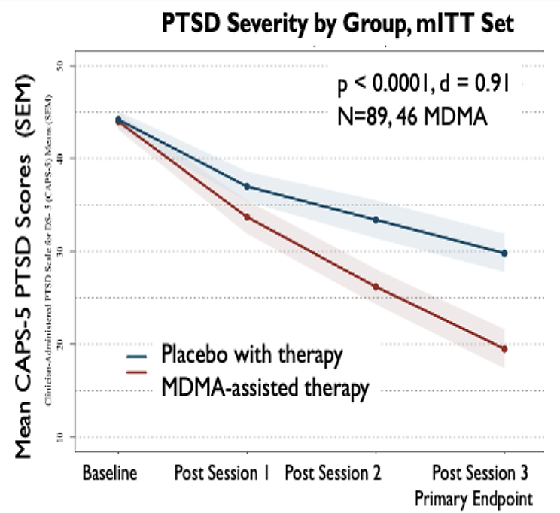
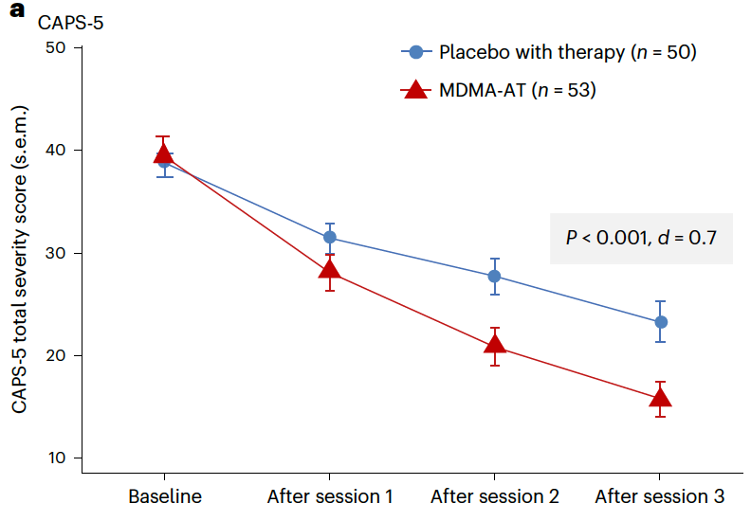
Key Findings Presented to FDA
MAPP1 (2021)
MAPP2 (2023)
Full references in Notes
PRE-DECISIONAL
Notes:
Mitchell JM et al. MDMA-assisted therapy for severe PTSD: a randomized, double-blind, placebo-controlled phase 3 study. Nat Med. 2021 Jun;27(6):1025-1033.
Mitchell JM et al. MDMA-assisted therapy for moderate to severe PTSD: a randomized, placebo-controlled phase 3 trial. Nat Med. 2023 Oct;29(10):2473-2480.

Slide 10
Key Concerns Raised by FDA
Key Concerns Raised by the FDA about industry-funded MDMA Phase III Trials
“Functional” unblinding of patients and therapists (attempts to blind participants were unsuccessful)
Expectancy based on participants’ prior MDMA use (which may have contributed to the failure to achieve blinding)
Inadequate safety monitoring (did not assess potential abuse/addiction outcomes, short follow-up)
Limited follow-up (18 weeks from initial prep session)
Non-evidence-based psychotherapy

Slide 11
Psilocybin Research Studies
Psilocybin has been combined with various psychotherapeutic components in at least 9 randomized clinical trials (RCTs) (N=~519) for depression or treatment-resistant depression
Psilocybin is taken during 1-3 ~6-hour sessions, typically with a 2-person facilitator team
A supportive psychotherapeutic framework consists of preparation sessions before and integration sessions after dosing +/- various evidence-based therapy (Chen et al., 2024; Horton, Morrison, & Schmidt, 2021)
RCTs have shown promising results for improving depression symptoms in primarily non-Veteran samples
1 study used inactive placebo, 5 studies used 'active placebo' such as niacin or low-dose psilocybin, 1 used low-dose psilocybin and escitalopram, 2 used delayed treatment comparator
Full references in Notes
Notes:
•Chen M-H, Cheng S-L, Kao Y-C, Tseng P-T, Hsu C-W, Yu C-L, Yang F-C, Thompson T, Hsu T-W and Liang C-S. The association between diverse psychological protocols and the efficacy of psilocybin assisted therapy for clinical depressive symptoms: a Bayesian meta-analysis. Front. Psychiatry. 2024;15:1439347. doi: 10.3389/fpsyt.2024.1439347.
•Horton, Morrison, & Schmidt. Systematized Review of Psychotherapeutic Components of Psilocybin-Assisted Psychotherapy. Am J Psychother 74:4, 2021

Slide 12
Psilocybin Research Studies (continued)
Two multisite Phase II RCTs have been completed:
Goodwin et al., 2022 (n=233)
Psilocybin 25mg vs 10mg vs 1mg (control) + psychological support
25mg vs 1mg, p<0.001; 10mg vs 1mg, p=0.18
Serious Adverse Events (SAEs) in 25mg group: suicidal ideation (2), nonsuicidal self-injury (2)
SAEs in 10mg group: suicidal ideation (1), nonsuicidal self-injury (1), hospitalization for severe depression (1)
SAEs in 1mg group: none
Blinding not assessed
Raison et al., 2023 (n=104)
Psilocybin 25mg vs niacin + psychological support, p<0.001
No treatment-emergent SAEs
Blinding not assessed
Full references in Notes
Notes:
•Goodwin, G. M., Aaronson, S. T., Alvarez, O., Arden, P. C., Baker, A., Bennett, J. C., ... & Malievskaia, E. (2022). Single-dose psilocybin for a treatment-resistant episode of major depression. New England Journal of Medicine, 387(18), 1637-1648.
•Raison, C. L., Sanacora, G., Woolley, J., Heinzerling, K., Dunlop, B. W., Brown, R. T., ... & Griffiths, R. R. (2023). Single-dose psilocybin treatment for major depressive disorder: a randomized clinical trial. Jama, 330(9), 843-853.

Slide 13
Psilocybin Research Studies (continued)
Two Phase III trials of psilocybin + psychological support for Major Depressive Disorder (MDD) or Treatment-Resistant Depression (TRD) are ongoing, including one trial with 5 VA sites
Functional unblinding and expectancy are also key concerns for psilocybin
No agreed upon standard for psychotherapy framework/psychological support
Psilocybin RCTs have also shown preliminary promise for alcohol use disorder, cancer-related anxiety/palliative care, and headache disorders

Slide 14
Lysergic acid diethylamide (LSD)
FDA granted Breakthrough Therapy designation in 2024 to LSD d-tartrate (MM-120; Mind Medicine) for the treatment of generalized anxiety disorder (GAD)
Clinical trials ongoing for GAD and other indications (depression, alcohol use disorder, cluster headache, palliative care, others)
Shows promise as a treatment for various mental health conditions, including depression, anxiety, and addiction.
Currently, 5 active interventional studies in the US, all with status of “recruiting” for MDD and GAD (1 study ongoing at VA)

Slide 15
Ibogaine
Shows promise for treating opioid use disorder (previous patent for this indication, now expired) by reducing withdrawal symptoms and cravings
Studies have shown longer term abstinence (up to 12 months) following a single dose of ibogaine (Noller et al 2018)
Open-label observational studies in Veterans with traumatic brain injury (TBI) and PTSD (received treatment outside U.S.)
In 30 male special operations forces veterans with TBI, magnesium-ibogaine therapy resulted in significant improvements in functioning both immediately and at 1 month as well as significant improvements on PTSD, depression and anxiety at 1 month after treatments (Cherian 2024)
Safety concerns including cardiotoxicity and seizures, may be mitigated by dosing with magnesium
Recent state-level legislation for research (Texas $50 million bill to support research).
Currently, no active interventional studies in the US.
Full references in Notes
Notes:
Noller et al. Ibogaine treatment outcomes for opioid dependence from a twelve-month follow-up observational study. Am J Drug Alcohol Abuse. 2018;44(1):37-46.
Cherian et al. Magnesium–ibogaine therapy in veterans with traumatic brain injuries. Nature Medicine volume 30, pages373–381 (2024).

Slide 16
Psychedelic Research in the Veteran Population
It is critical to validate findings in the Veteran population
VA is committed to safely exploring all avenues that promote the health of our Nation’s Veterans
Veterans often have more complex mental health disorders and treatment needs than the general population.
Some treatments for PTSD and depression that have proven effective in the general population have subsequently been found to be ineffective or less effective in the Veteran population
Methodological and Implementation Considerations
Functional unblinding due to psychoactive effects of these compounds
Treatment protocols vary across studies and are very different from current standard clinical workflows – space redesign, clinician time, training, etc.
PRE-DECISIONAL

Slide 17
VHA’s Psychedelic Medicine Background
VHA has proactively been preparing for the potential future clinical deployment of psychedelic medicine for some time.
For several years, OMH and ORD have been meeting to monitor the developing scientific literature on psychedelics and to explore issues related to possible future clinical implementation of psychedelic medicine in VHA.
A State of the Art (SOTA) Conference was held in September 2023 exploring preclinical and translational research, clinical research, clinical practice logistics and implementation, as well as system-wide clinical decision-making.
VA’s ORD published its first Request for Application (RFA) for psychedelics research in January 2024. The first study was selected for funding in fall 2024, and three additional studies have been selected for funding in subsequent scientific review cycles.
In April 2024 VHA formally chartered an IPT that is co-chaired by OMH and ORD.
PRE-DECISIONAL

Slide 18


Launch of VA Funded Research
VA published a funding opportunity announcement and RFA from the VA research community in January 2024.
Scientific peer review of new proposals from VA researchers is ongoing and funding decisions occur on a rolling basis.
VA ORD staff will work with Principal Investigators (PI) to coordinate the start-up of studies approved for VA funding and inform/coordinate with VA leadership.
PRE-DECISIONAL

Slide 19
Current State of VA Research
As of October 2025, there are a total of 24 studies in active status:
16 clinical studies for mental health conditions
2 non-clinical for mental health condition
5 clinical studies for other conditions (e.g. headache, pain)
1 non-clinical for other conditions
Three ORD funded clinical trials have been selected for funding are preparing to begin:
MDMA-Assisted Therapy for Veterans with PTSD and Alcohol Use Disorder: A Randomized Controlled Trial
A Multi-site Randomized Controlled Trial of Psilocybin for TRD in Veterans
Safety, efficacy, and mechanisms of psilocybin-assisted Acceptance and Commitment Therapy (PACT) in treating MDD among Veterans
One pre-clinical study at the Baltimore VA has been selected for ORD funding
It is estimated that non-VA funding sources will provide over $23 million to VA for psychedelic research
PRE-DECISIONAL

Slide 20
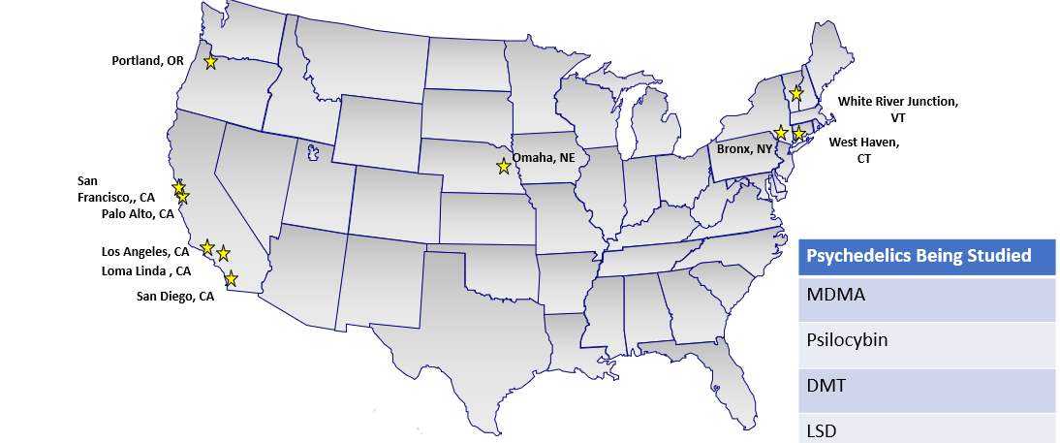
Current Sites of Clinical Mental Health Studies
PRE-DECISIONAL

Slide 21


VHA Psychedelics IPT Overview
Purpose of IPT:
The VHA Psychedelics IPT is chartered to develop a comprehensive implementation plan for the future clinical deployment of safe and effective psychedelic treatments for mental health conditions in VHA.
Efforts of the IPT will accomplish the following:
Advise Under Secretary for Health (USH) on key issues associated with psychedelic medicine for mental health treatment.
Develop written guidance for research and clinical deployment of psychedelic medicine in VHA.
Develop a program evaluation structure that supports data-driven decisions about psychedelic medicine in VHA.
Scope:
The IPT focuses on psychedelic treatment applications for mental health treatment only.
Non-mental health applications are not addressed by this IPT.
Initial focus of efforts will be on psychedelic treatments in Phase 3 Clinical trials for mental health conditions. Efforts may expand over time.
PRE-DECISIONAL
21

Slide 22
VHA Psychedelics IPT Metaframework
External VA Stakeholders
VHA Under Secretary for Health
Internal VA Stakeholders: VA Program Offices & Staff
Veterans
Families
Caregivers
VSOs
General Public
Media
Deputy Under Secretary for Health
PC
PBM/Ethics
VHA Comms
CBI
Ops
Clinical Services
VEO
Congress
White
House
Other Gov.
Agencies
Executive Sponsor
Exec Sponsor: Dr. Lisa Kearney
QSV
HOC
CSO
Risk Mgt
Support Services
WMC
Private
Healthcare
Pharmaceutical Companies
VISNs
OIT
DEAN
Clinical
Staff
VHA Finance
iLEAD
Executive Leads
Dr. Ilse Wiechers (OMH)
Dr. Wendy Tenhula (ORD)
Connected Care
VAMCs
API
OGC
OCLA
Executive Steering Committee
Change Management and Communications (Operational/Strategic)
WS 1: Research
WS 2: Clinical Implementation
WS 3: Training
WS 4: Informatics & Evaluation
WS 5: Community Care
Workstream Co-Leads:
Paula Schnurr (NCPTSD)
Miriam Smyth (ORD)
Workstream Lead:
Eric Hermes (OMH)
Workstream Co-Leads:
Stacey Pollack (OMH)
Dave Oslin (VISN)
Workstream Co-Leads:
Ilan Harpaz-Rotem (NEPEC)
Workstream Co-Leads:
Allyene Lacey (IVC)
Eric Hermes (OMH)
IPT members are meeting regularly with key NGOs and other federal agencies:
Compass Pathways
Resilient Pharmaceuticals (formerly Lykos)
Usona
SAMHSA
Updated October 2025
PRE-DECISIONAL

Slide 23
Proposed FY26 Priorities for Psychedelic IPT
Establish and implement plan for VA leadership vetting process for psychedelic related activities
Research/Investigator activities (facility based)
IPT activities (VHACO based)
ORD activities (VHACO based)
Training and education
Create general provider training
Enduring content available (optional) for front line providers that will educate on state of the science and regulatory landscape to support their conversations with Veterans asking about psychedelics
Establish plan for training providers to prepare for future potential clinical implementation
Identify which protocols should be prioritized
Determine internal VA training program vs external training programs
How to prioritize providers/sites to receive training
Continued support for VA research
PRE-DECISIONAL

Slide 24





Discussion
PRE-DECISIONAL

